Slide 1
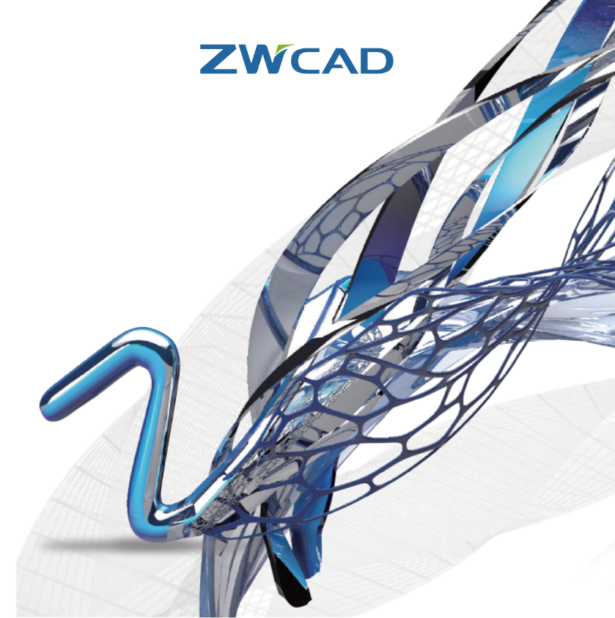
Overview Video
ZWCAD 2018
ZWCAD 2019
ZWCAD is a powerful, reliable and DWG compatible CAD solution for worldwide users.
cadfocus

Slide 2
Compelling Reason to consider ZWCAD Software Solution
Great Cost SAVING $$$$ ( Software License & PC Hardware ) !!!
Ease of Use / Adaption (AutoCAD work alike)
Read / Write AutoCAD DWG (R14 - 2018) Format
Familiar User Interface : Classic / Ribbon
Programming Support : LISP, VBA, ZRX, .Net..
Flexible Perpetual Licensing : Permanent Standalone / Network
Large Established Client Base in Malaysia ( >900,000 Worldwide)
Affordable / Low System Requirements
International Copyright Assured !
More…
cadfocus

Slide 3
Users Reference
ZWCAD User References
( Malaysia )
Engineering – AEC Construction
Architectural / Interior
Land Surveying
Government
Engineering – Oil & Gas
Engineering – AEC
cadfocus

Slide 4
Users Reference
cadfocus

Slide 5
Users Reference
cadfocus

Slide 6
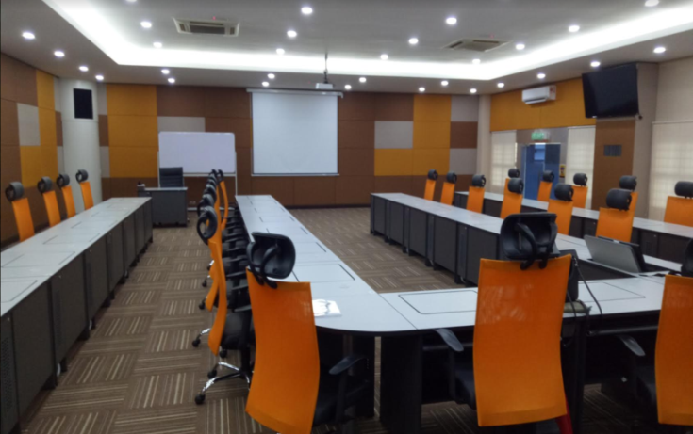
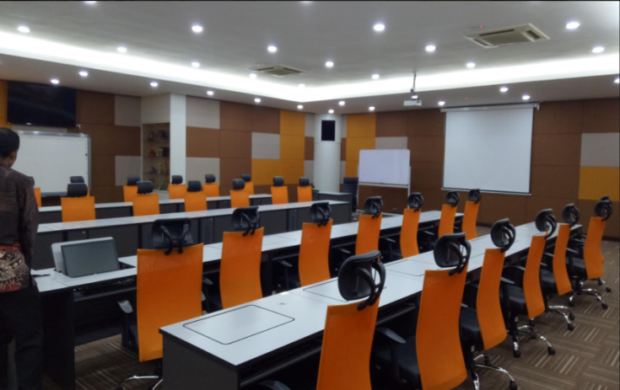
2018 Key Government Account Success
Total Purchase
ZWCAD PRO 36 Licenses
Update Training
cadfocus

Slide 7
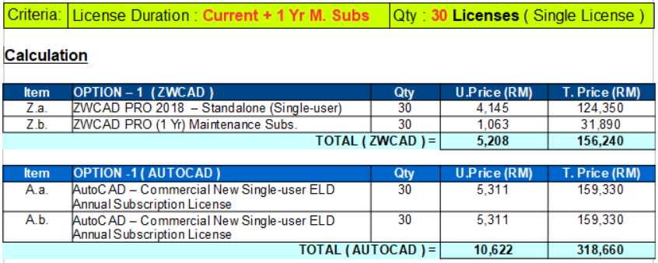
Cost Comparison: ZWCAD vs AutoCAD (Commercial version)
Note: Pricing (ZWCAD & AutoCAD) base on Feb 2019 price book and subject to change without prior notice.
cadfocus

Slide 8
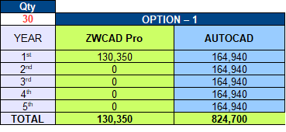
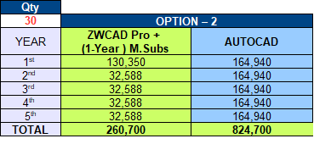
Cost Comparison: ZWCAD vs AutoCAD (Commercial version)
SUMMARY
ZWCAD Permanent License without Expiry Date
ZWCAD License
ZWCAD License + Maintenance Subs
Note (Option 1) :
ZWCAD version remain the same throughout the years of usage.
AutoCAD License use is yearly base and need to renew every year. Free upgrade to latest version every year
Note (Option 2) :
With Maintenance Subscription option purchase, free upgrade to latest version every year.
AutoCAD License use is yearly base and need to renew every year. Free upgrade to latest version every year.
Note: Pricing (ZWCAD & AutoCAD) base on February 2019 price book and subject to change without prior notice.
cadfocus

Slide 9
Price List
Item | Product Description | Qty | Price (RM)
1. | ZWCAD Pro 2019 – S/A 2D & 3D Design Drafting Features License Use : Permanent | 1 | 4,345
2. | ZWCAD Std 2019 – S/A 2D Design Drafting Features License Use : Permanent | 1 | 3,040
3. | ZWCAD Pro 1 year Maintenance Sub (Option) FOC Upgrade | 1 | 1,220
4. | ZWCAD Std 1 year Maintenance Sub (Option) FOC Upgrade | 1 | 760
Note: Above Price List valid till 30th April 2019
cadfocus

Slide 10
TAMAT
SEKIAN TERIMA KASIH

